Slide 1

What is Hadoop ?
an open source software platform for distributed storage and distributed processing of very large data sets on computer clusters built from commodity hardware

Slide 3
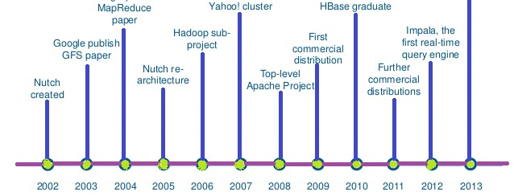
Between 2003 and 2004, Google published the papers on GFS (Google File System) and MapReduce.
Around the same time, Yahoo! was developing an open-source web search engine called “Nutch.”
In 2006, Hadoop’s core development was led by Doug Cutting and Tom White.
Since then, Hadoop has continued to evolve.

Slide 4

Hadoop name ?
“Hadoop” was the name of a toy elephant belonging to Doug Cutting’s child.
It was a unique, untrademarked term, making it memorable and easy for an open-source project name.

Slide 5
Why Hadoop ?
Huge Data: Hadoop can handle massive amounts of data (terabytes daily) by spreading it across many computers.
Scalable: Instead of upgrading one powerful machine, you simply add more regular (commodity) computers to the cluster.
Fault-Tolerant: If one machine fails, Hadoop’s data replication ensures no data is lost.
More Than Batch: Originally for batch processing, Hadoop’s ecosystem (like Spark, Kafka) now supports real-time and interactive tasks.

Slide 6
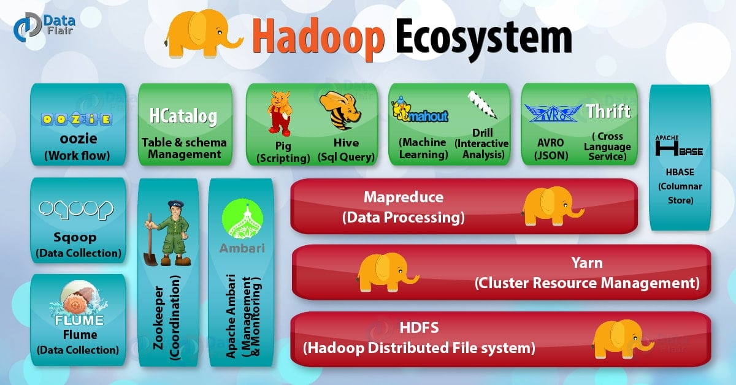
Hadoop Ecosystem
Source:https://data-flair.training/blogs/wp-content/uploads/sites/2/2017/04/Hadoop-Ecosystem-2-01.jpg

Slide 7
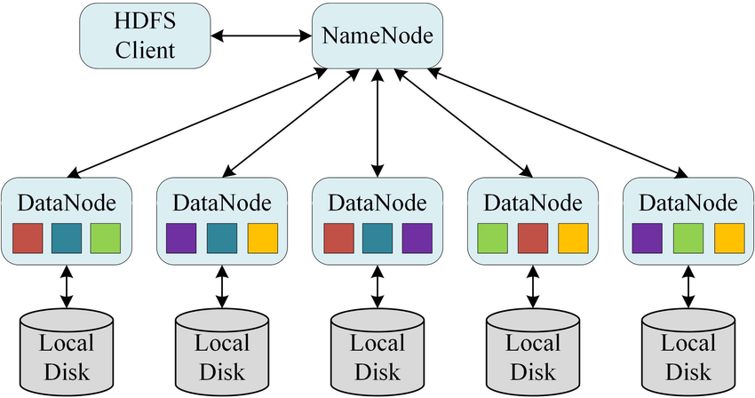
Introduction to HDFS
A distributed file system used in Hadoop
Stores large data across multiple machines
Designed for fault tolerance and scalability
Handles Big Data efficiently
Works on commodity hardware
Provides high throughput for data access
Uses replication to prevent data loss
Source: Jianbo, Zhang & Ye, Zhuangzhuang & Zheng, Kai. (2021). A Parallel Computing Approach to Spatial Neighboring Analysis of Large Amounts of Terrain Data Using Spark. Sensors. 21. 365. 10.3390/s21020365.

Slide 8
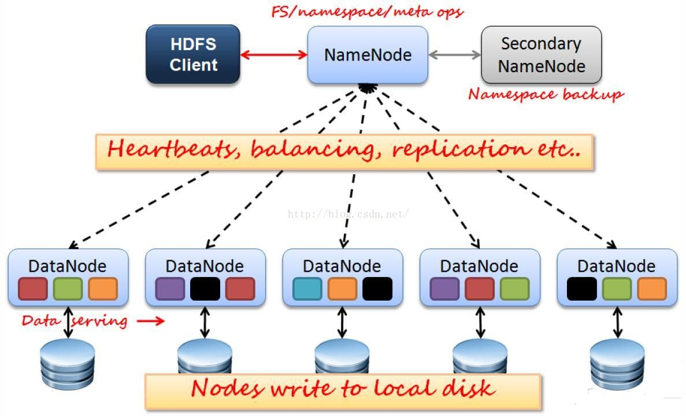
Main Components:
1️⃣ Namenode 📌 (Master)
Manages file system metadata
Keeps track of file locations
2️⃣ Datanodes 📦 (Workers)
Store actual data
Report to Namenode
3️⃣ Secondary Namenode 🔄
Not a backup!
Merges filesystem changes
📌 How it Works?
Files split into blocks (default: 128MB or 256MB)
Blocks are replicated (default: 3 copies)
Each block is replicated for fault tolerance
Source:https://library.fiveable.me

Slide 9
HDFS
📝 How Reading Works? 1️⃣ Client asks Namenode for file location 2️⃣ Namenode provides block locations 3️⃣ Client reads directly from Datanodes
📝 How Writing Works? 1️⃣ Client asks Namenode for file creation 2️⃣ File is split into blocks 3️⃣ Blocks are written to multiple Datanodes
✔️ Advantages: ✅ Scalability: Handles petabytes of data ✅ Fault Tolerance: Replication prevents data loss ✅ High Throughput: Optimized for batch processing
❌ Limitations: 🚫 Not suitable for real-time processing 🚫 High latency for small files 🚫 No random writes, only append

Slide 10
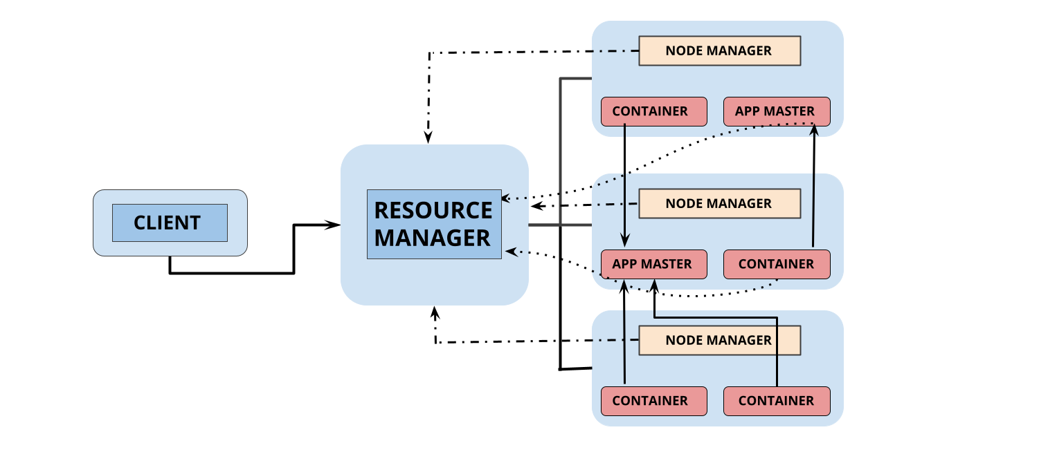
Introduction to YARN
YARN is the resource management layer of Hadoop.
Manages CPU & memory across the cluster.
Allows multiple applications (MapReduce, Spark, etc.) to run on the same cluster.
Overcomes limitations of classic Hadoop (single JobTracker bottleneck).
Supports multi-tenancy (multiple applications run simultaneously)
Efficient resource allocation & scheduling.

Slide 11

Introduction to MapReduce
A processing framework in Hadoop for Big Data.
Divides a task into smaller sub-tasks (Map) and processes them in parallel.
After processing, the results are combined (Reduce) to get the final output.
Parallel Processing → Faster computation.
Scalable → Works on large datasets across many machines.
Fault Tolerant → Handles failures automatically.

Slide 12
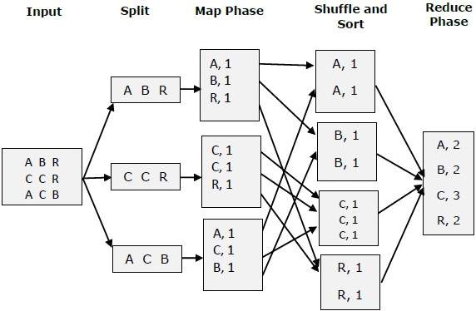
MapReduce Workflow
Input Data (Stored in HDFS) Splitting: Data is divided into chunks (blocks). Mapping: Processes each chunk separately. Shuffling & Sorting: Groups similar data together. Reducing: Aggregates and finalizes the output. Final Output: Stored in HDFS.

Slide 13
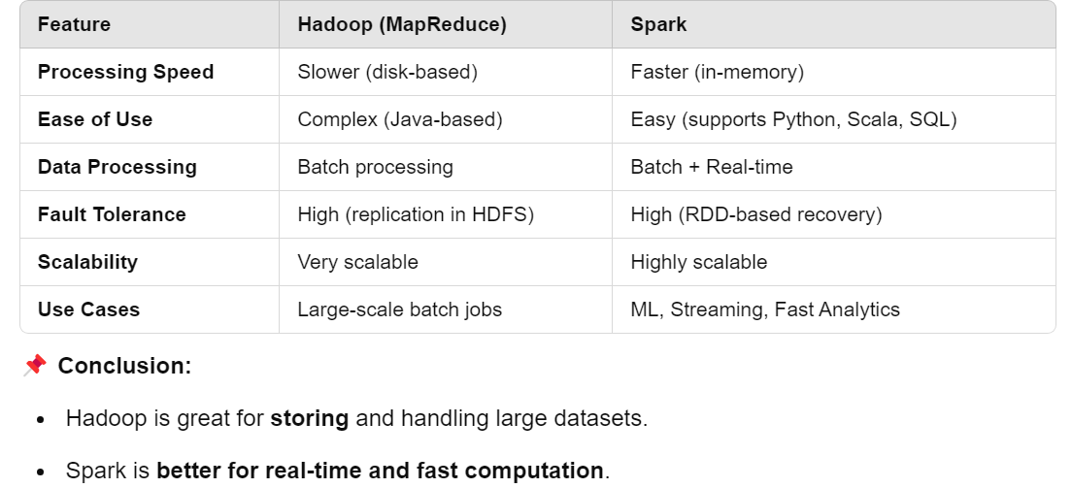
Apache Spark vs. Apache Hadoop
Cloud-based big data platforms (AWS, Azure, Google Cloud)
More use of Spark over MapReduce HDFS is still used for storage but alternatives like Amazon S3 and Databricks Delta Lake are growing
Hadoop’s MapReduce component is becoming outdated, but HDFS and YARN are still widely used.
So, Spark is not replacing Hadoop completely—it's replacing Hadoop MapReduce, but Hadoop's storage (HDFS) is still widely used.

